Slide 1
Simulating Homelessness

Slide 2
Reducing Homelessness
The Housing Opportunities Made Easier (HOME) Act of 2019
New grant administered by HUD for best investments in reducing chronic homelessness
These HOME Grants can be distributed to any number of states for any variety of federal programs even if indirectly aimed at reducing homelessness
Optimize the reduction of chronic nationwide homelessness in the US

Slide 3
Objective
To create a model that will help us understand the driving factors behind homelessness such that it will help inform policymakers how to effectively allocate HOME grant funds in a way that would optimize taxpayer dollars.

Slide 4
Methodology
Use R to perform exploratory data analysis.
Build Regression model to identify statistically significant variables.
Use identified variables to run Excel Solver simulation to determine optimal coefficients
Use new model to create Monte Carlo simulation with 100,000 paths to determine optimal allocation of funds.
Make recommendations on how to allocate HOME funds to effectively reduce homelessness in the United States

Slide 5
Data
2017
State
Emergency Shelter
Total Spending
Total Support Services
Total State Expenditure
Transitional Housing
Total Gross State Product
Unemployed
Number in Poverty
Edu Support Service
Homeless Population
Transitional Housing
Safe Haven
Affordable Housing
Number without Health Coverage
Median Income
Total State Gross Product

Slide 6
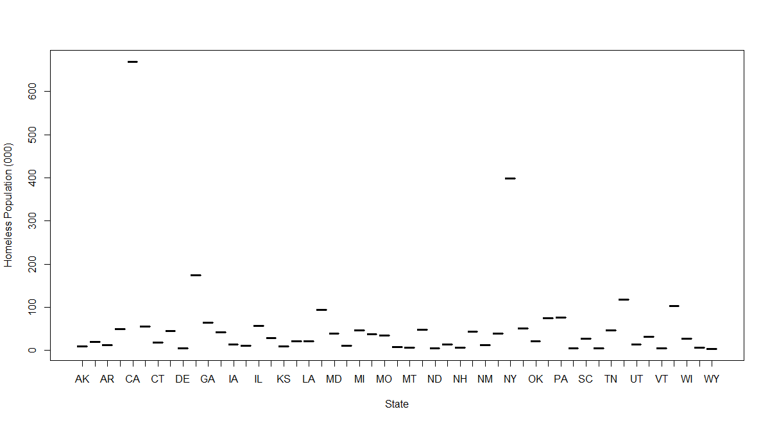
Homeless Distribution by State
Notes:
CA and NY have the most Homeless Population

Slide 7
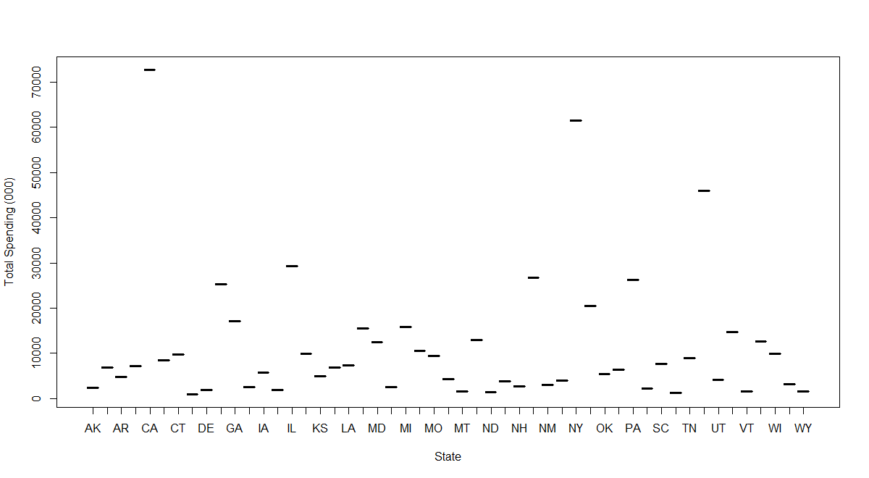
Total Spending on Homeless by State
Notes:
As one would expect, NY and CA are the states that spend the most on homeless related activities

Slide 8
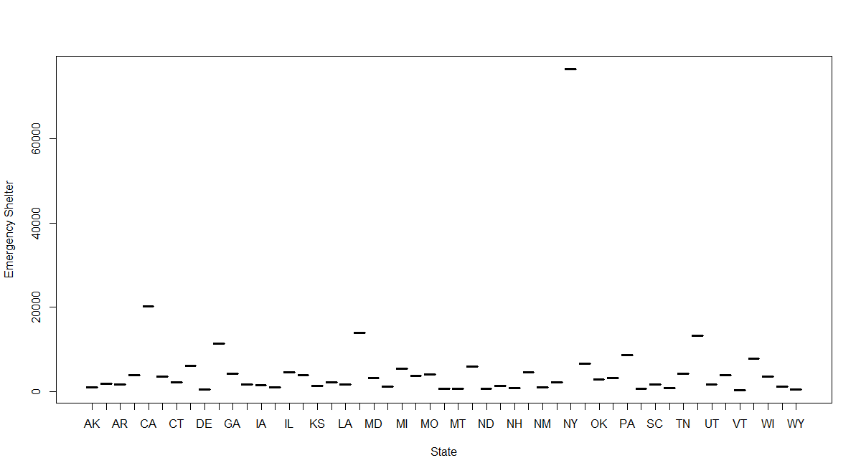
Emergency Shelter by State
Notes:
However, NY has more emergency shelters than CA even though CA has 67% more homeless people than NY

Slide 9
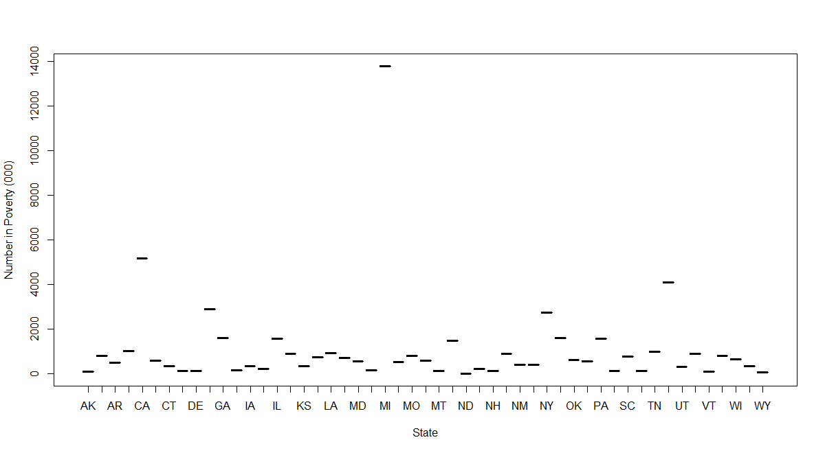
Number in Poverty by State
Notes:
Further, MI seems to have a much higher number of people in poverty than NY and CA

Slide 10
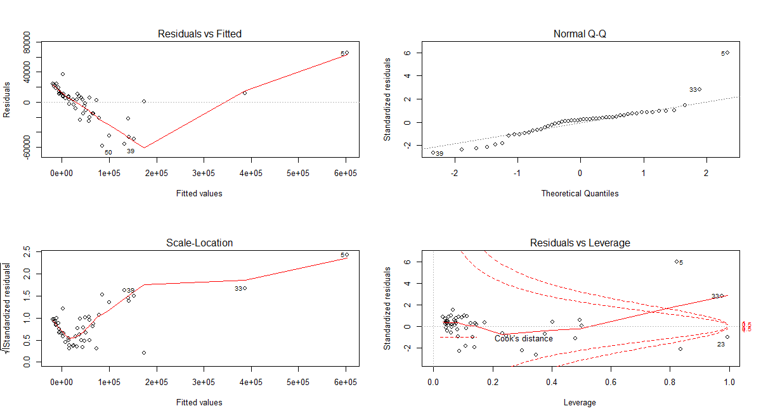
Linear Regression Model
Notes:
Using the data at hand, we built a regression model to help us understand the most inflectional variables.
The regression model resulted in an Adjusted R squared of 0.94 and found the following variables to be statistically significant
"emergency_shelter", "total_spending", "total_support_services", "total_state_expenditure",
"transitional_housing", "total_gross_state_product", "Unemployed", "number_in_poverty“.
Looking at the fitted values vs Residual plot, we can see that the model seems to explain the distribution of homelessness across the state.

Slide 11
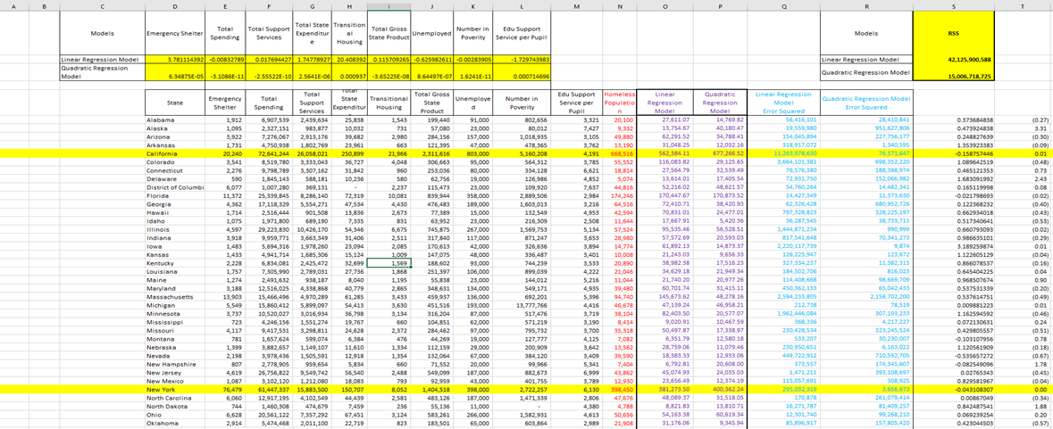
Excel Solver Optimization
Notes:
With the variables identified at hand we built two models; a linear regression and quadratic regression model.
We then optimized the model by changing the coefficients such that the RSS was minimized
We had one constraint; homeless predictions for each state must be greater than zero

Slide 12
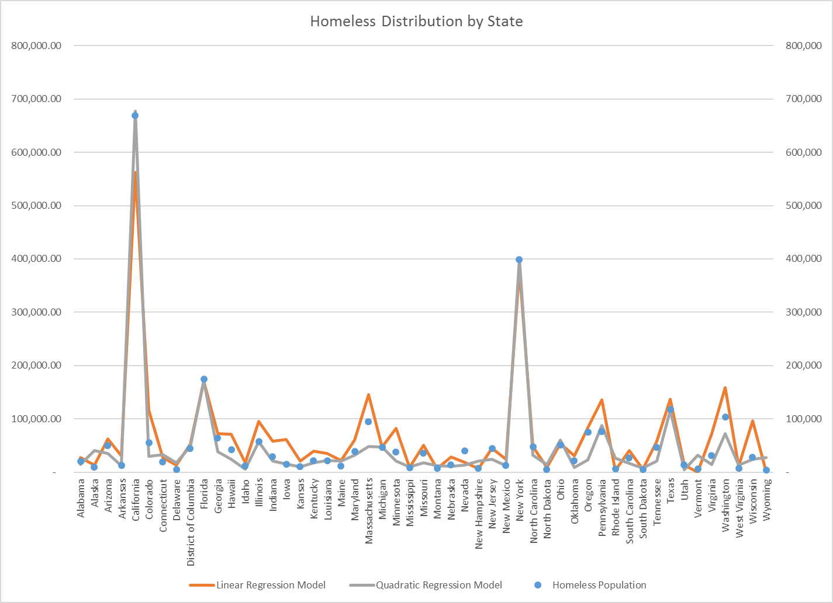
Optimization Result
Notes:
The orange line is the regression model, the gray line is the quadratic model, and the blue dots are actual homeless population by state
As you can see, the quadratic model seems to do the best job at fitting the data

Slide 13
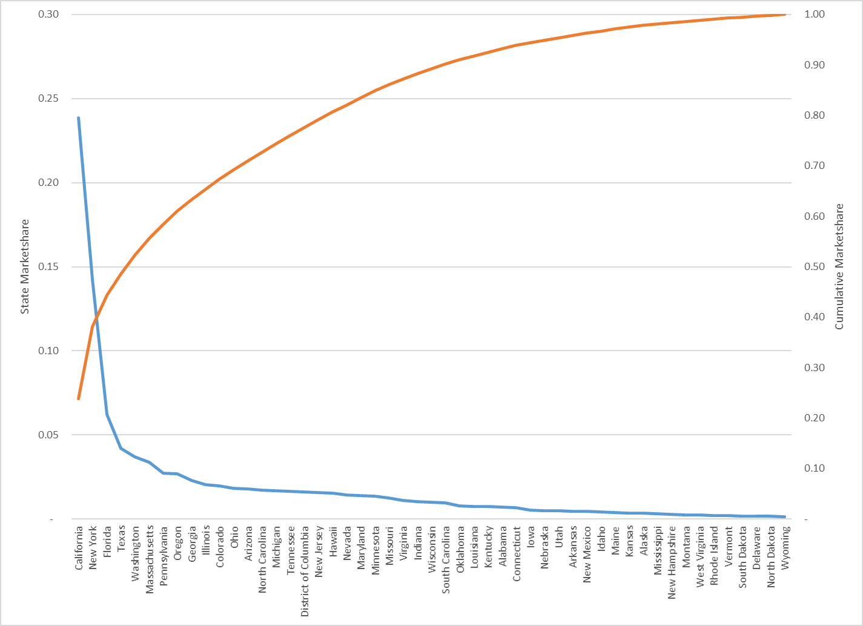
Homeless Distribution
Notes:
Here we have the homeless marketshare and cumulative marketshare. As you can see, NY and CA account for about 40% of the homeless population yet represent only 4% of our state total. As a result, we suggest using NY and CA data when building a monte carlo simulation model.

Slide 14
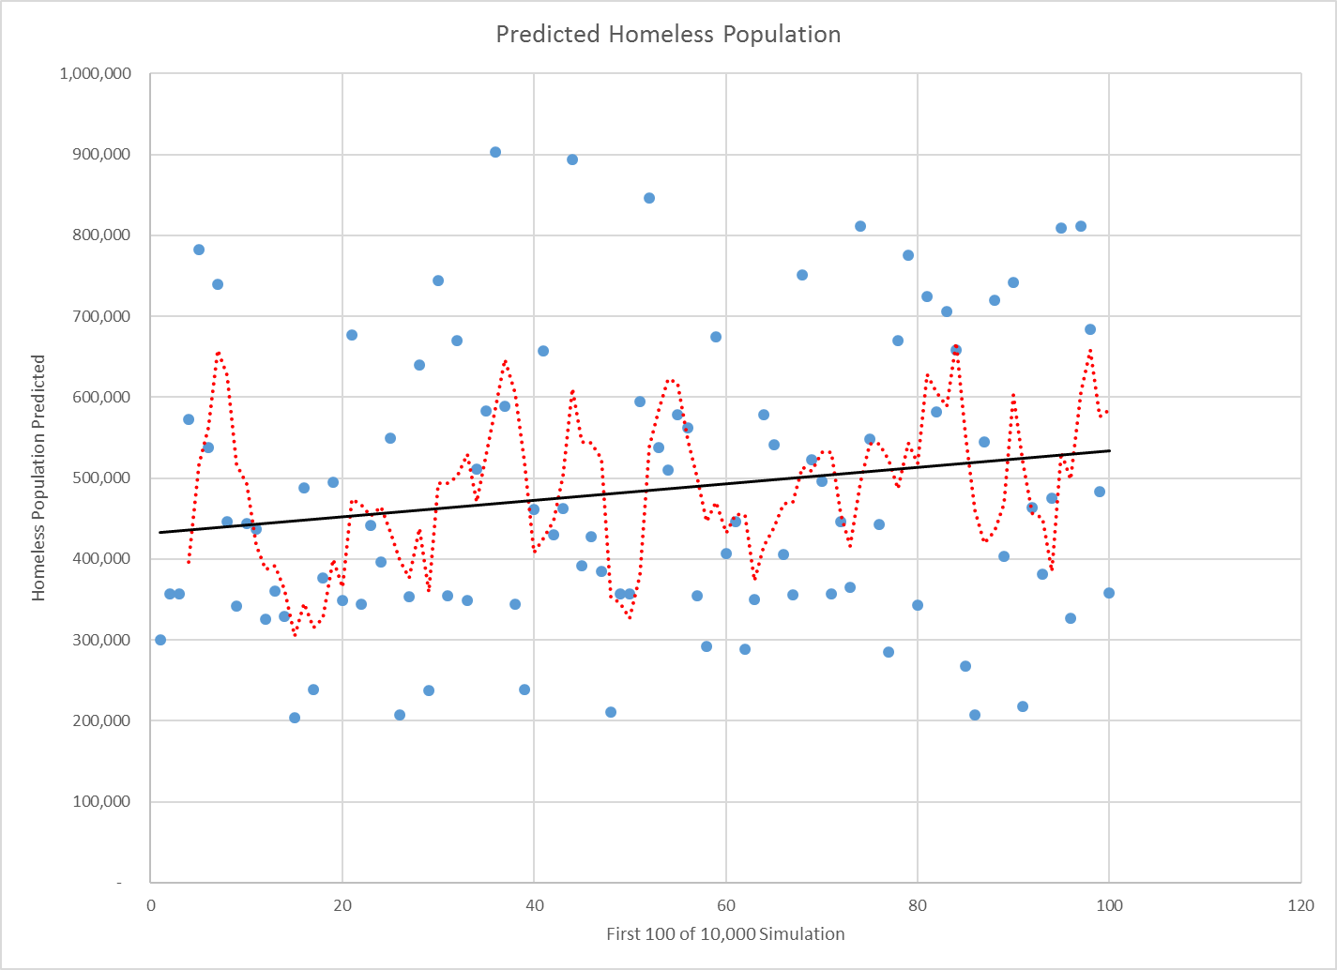
Monte Carlo Simulation

Slide 15
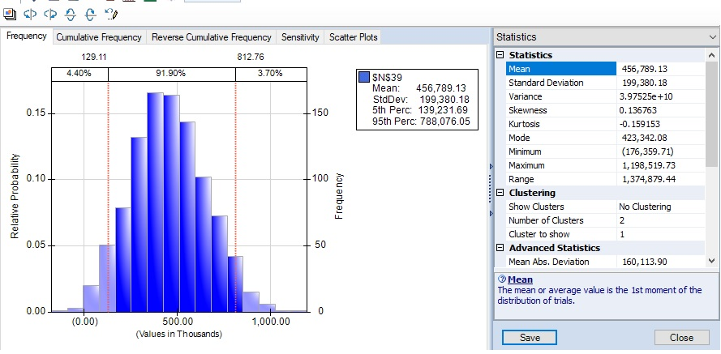
Simulation Summary

Slide 16
Conclusion
To optimize HOME grant funds, we recommend
Focus on key states – NY and CA
Increase spending in homelessness supportive services (better care for the homeless population)
Increase Total Gross State Product (improve state economy)
Reduce unemployment and people in poverty
Notes:
Return on Investment – Coefficients

Slide 17
Recommendations
Department of Housing and Urban Development (HUD)
Homeless Assistance Grants – Continuum of Care (CoC) Program
Transportation Grants to States
‘Last Mile’ Programs
Larger Transportation Projects
Lower Income Housing Tax Credit (LIHTC)

